Slide 1
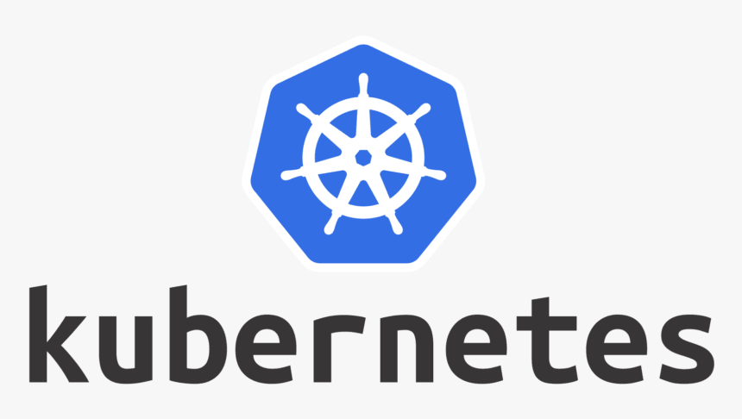

Slide 2
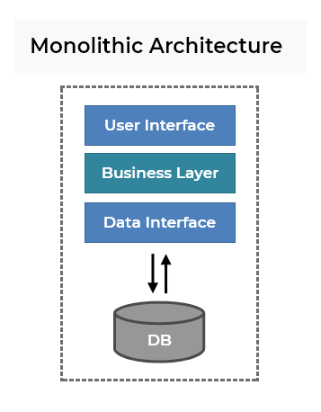
What is Monolithic Applications ?
Monolithic applications are designed to handle multiple related tasks. They’re typically complex applications that encompass several tightly coupled functions.
For example, consider a monolithic ecommerce SaaS application. It might contain a web server, a load balancer, a catalog service that services up product images, an ordering system, a payment function, and a shipping component.
As you can imagine, given their broad scope, monolithic tools tend to have huge code bases. Making a small change in a single function can require compiling and testing the entire platform, which goes against the agile approach today’s developers favor.

Slide 3
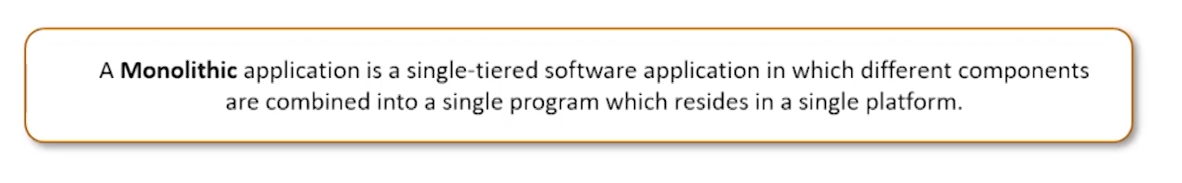
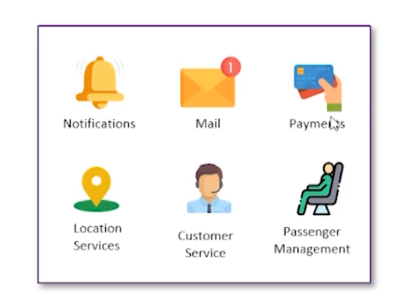
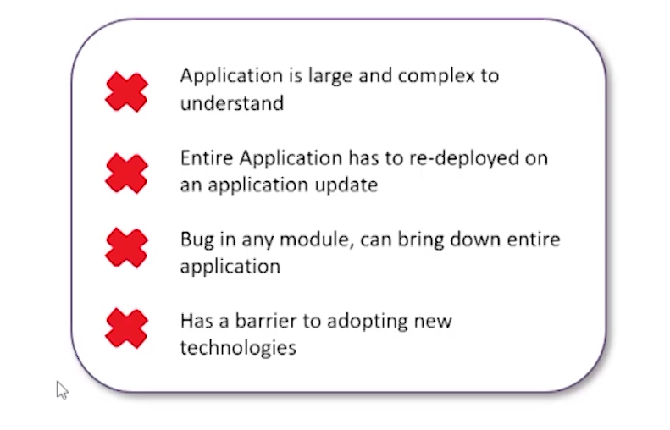

Microservices
Disadvantages

Slide 4
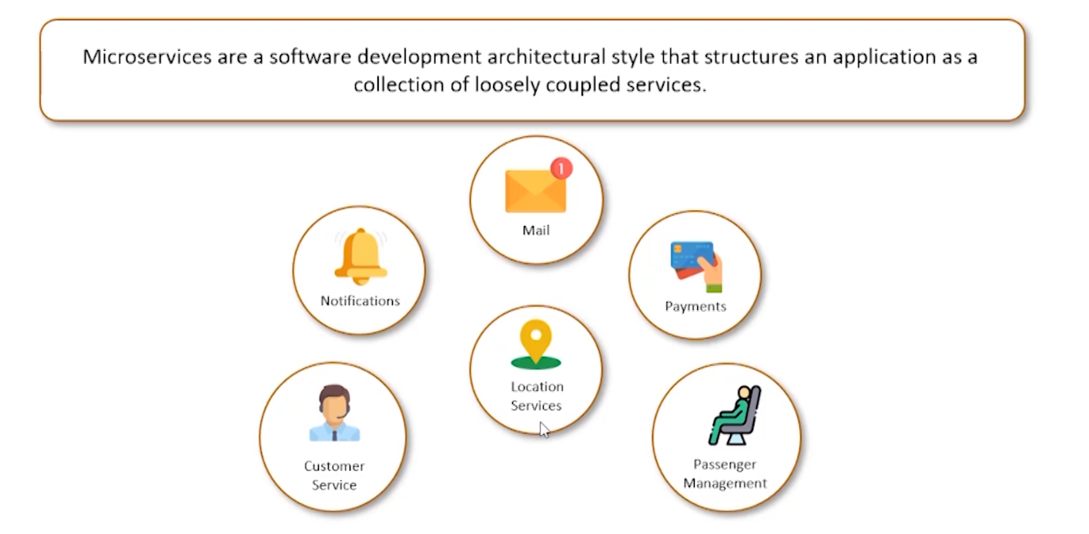
Microservices

Slide 5
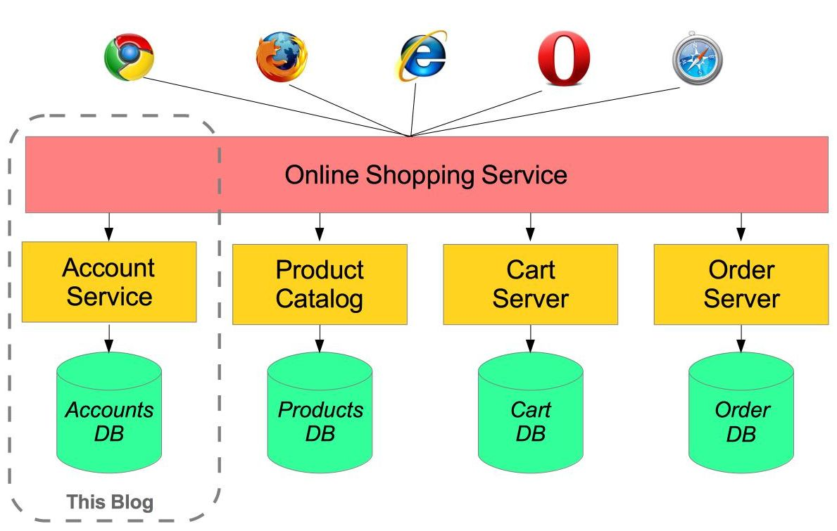
What are microservices?
In contrast to the monolithic approach, a microservices architecture involves smaller applications deployed independently as loosely coupled services, tied together through application integration. With microservice applications, the business logic may encompass multiple platforms, including software as a service, on-premises databases, and in-house-developed applications that meet needs that no SaaS application handles.
From a software engineering perspective, microservices can be simpler to develop. They’re smaller in scope and therefore smaller in size, which makes it easier for developers to improve them through continuous integration and continuous delivery (CI/CD). They can be written in any programming language. And they can communicate with other microservices through APIs.
An application programming interface (API) is a set of programming calls that expose the functionality of an application to developers. APIs make it simpler to develop integrated applications by offering an easy way to pass credentials and data between applications.

Slide 6
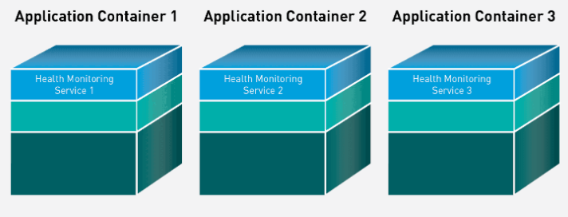
container
A container is a standard unit of software that packages up code and all its dependencies so the application runs quickly and reliably from one computing environment to another.
A Docker container image is a lightweight, standalone, executable package of software that includes everything needed to run an application: code, runtime, system tools, system libraries and settings.
Container images become containers at runtime and in the case of Docker containers – images become containers when they run on Docker Engine. Available for both Linux and Windows-based applications, containerized software will always run the same, regardless of the infrastructure.
Containers isolate software from its environment and ensure that it works uniformly despite differences for instance between development and staging.

Slide 7
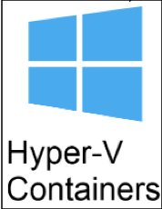

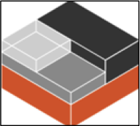



Containerization Tools
containerd
LXC (Linux)
Hyper-V and Windows Containers
Rkt(Rocket)
Podman
runC

Slide 8
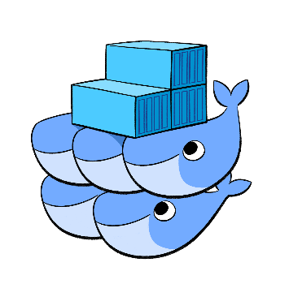
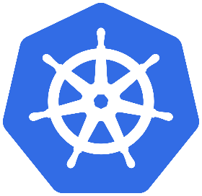
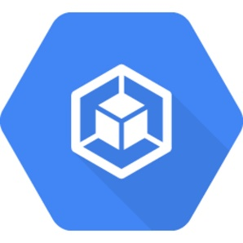


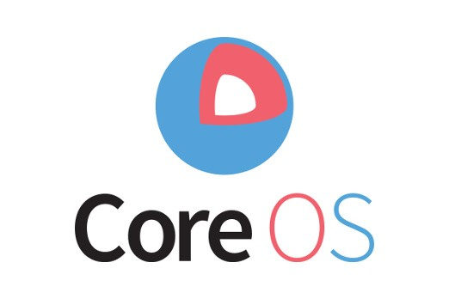
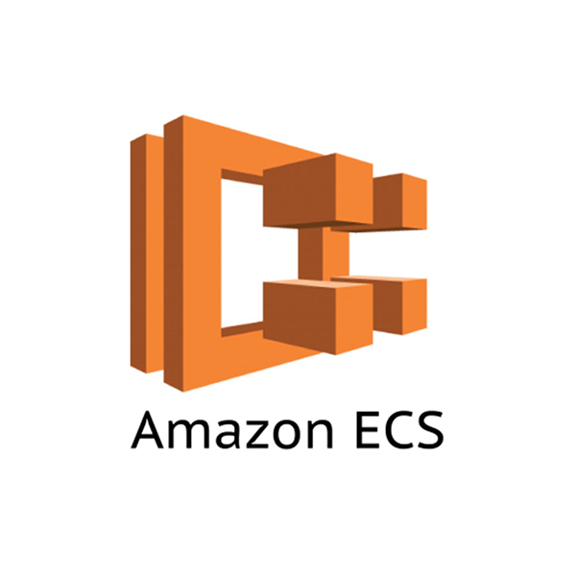
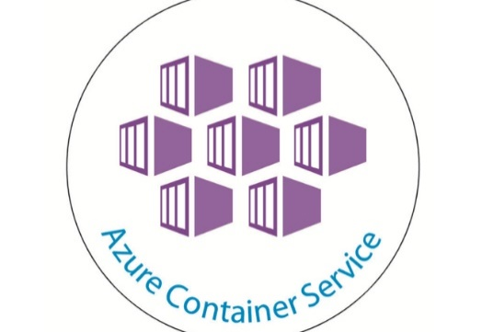
Container Management tools
Docker Swarm
Kubernetes
Google Container Engine
Cloud Foundry Diego
Mesosphere Marathon
Core OS Fleet
Amazon Elastic Container Service
Azure Container Service

Slide 9
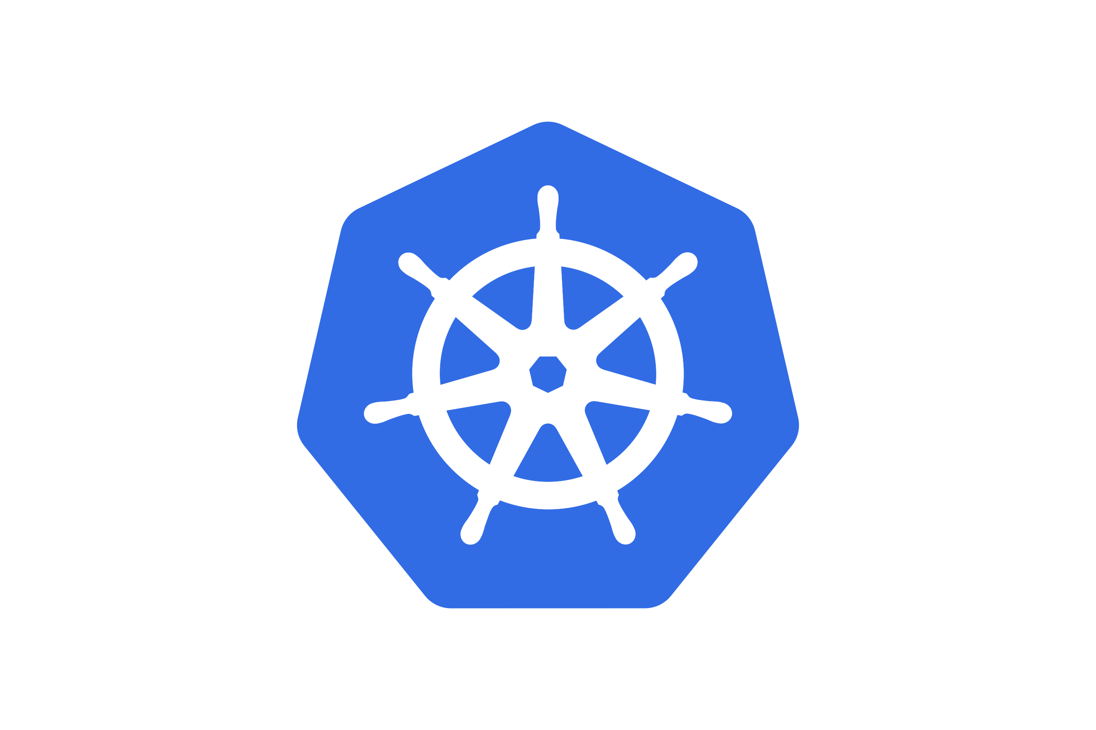
KUBERNETES (K8s)
Kubernetes is an open-source container management tool which automates container deployment, container scaling and load balancing.
It schedules, runs and manages isolated containers which are running on virtual/ physical/ cloud machines.
All top cloud providers support Kubernetes.
History
Google developed an internal system called ‘borg’ (later named as omega) to deploy and manage thousands google application and services on their cluster.
In 2014, google introduced Kubernetes as an open-source platform written in Golang, and later donated to CNCF (Cloud Native Computing Foundation).

Slide 10
Online platform for K8s:
Kubernetes playground
Play with K8s
Play with Kubernetes classroom
Cloud based K8s services:
GKE: Google Kubernetes Services
AKS: Azure Kubernetes services
Amazon EKS: Amazon Elastic Kubernetes Services
Kubernetes installation tool:
Minicube
Kubeadm
Problems with scaling up the containers:
Containers cannot communicate with each other.
Auto scaling and load balancing was not possible.
Containers had to be managed carefully.

Slide 11
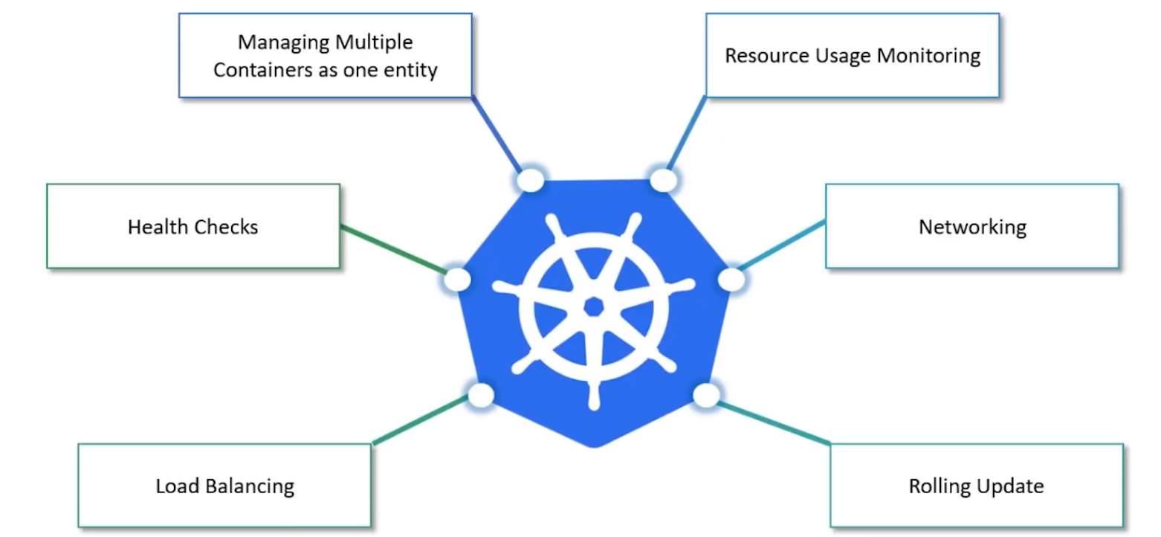
Features of Kubernetes:

Slide 12
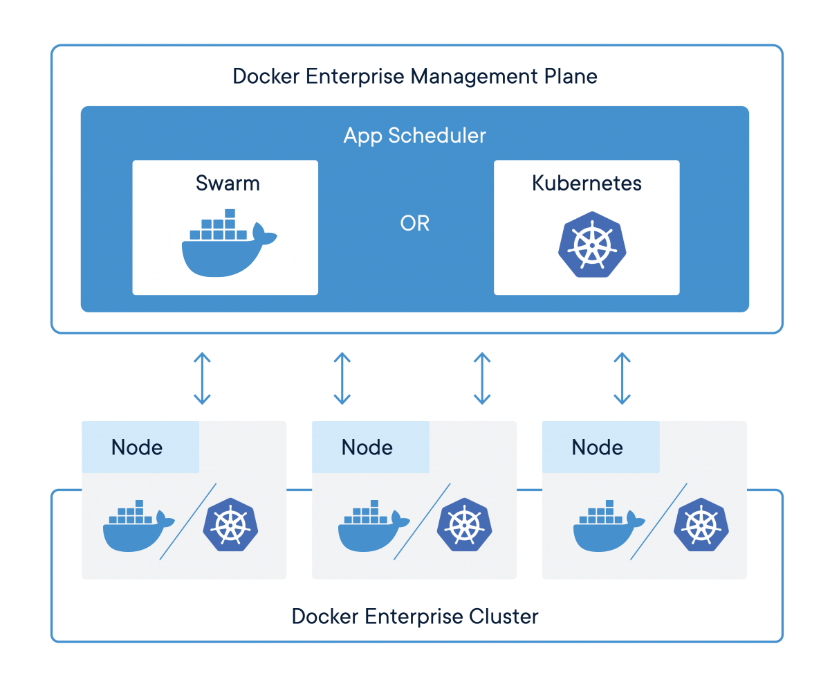
Kubernetes & Swarm

Slide 13
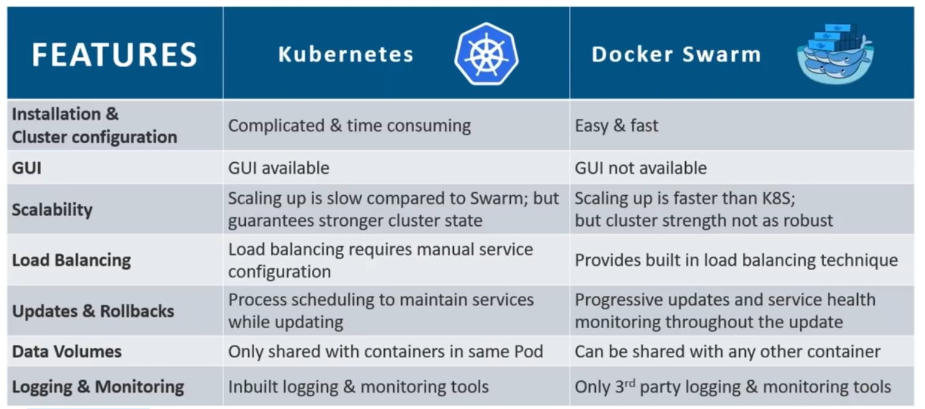

Slide 14
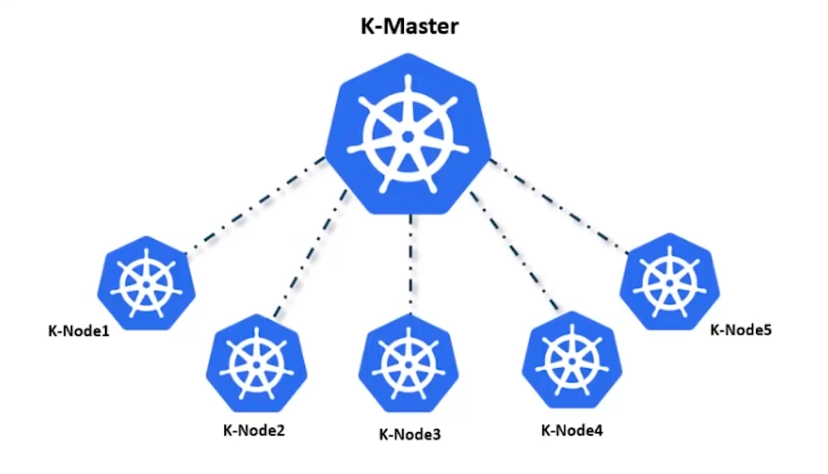
Working with Kubernetes:
Role of Master Node:
Kubernetes cluster contains containers running or bare metal/ vm instances. Cloud instances/ all mix.
Kubernetes designates one or more of these as master and all others as workers.
The master is now going to run set of k8s processes. These processes will resume smooth functioning of cluster. These processes are called “control plane”.
Can be multi-master for high availability.
Master runs control plane to run cluster smoothly.

Slide 15
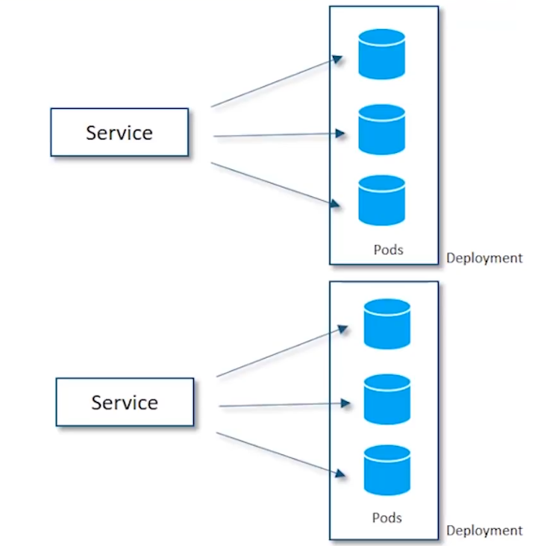
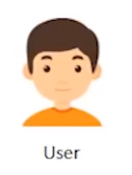
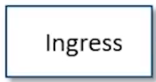
Kubernetes Architecture

Slide 16
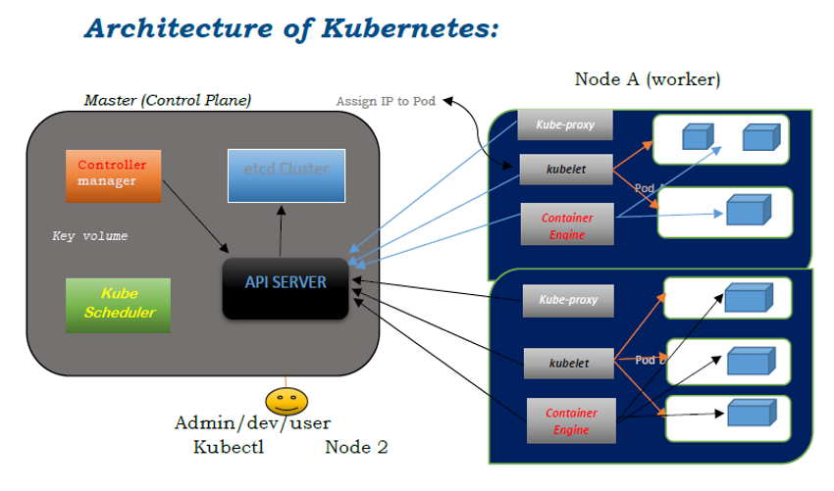

Slide 17
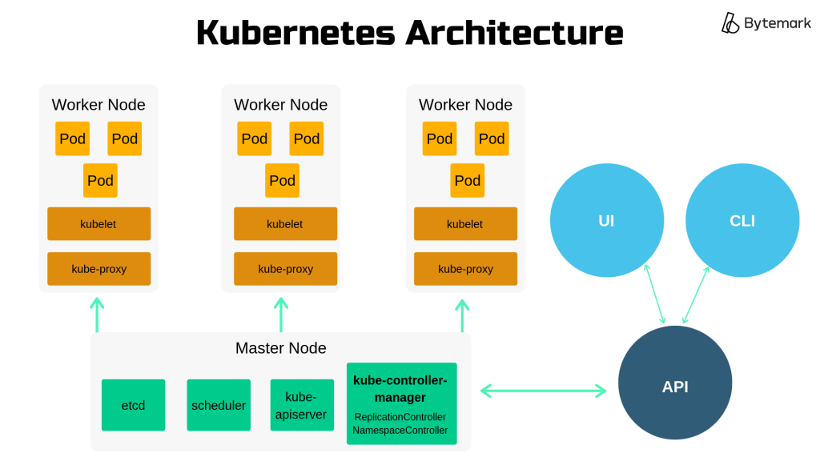

G

Slide 18
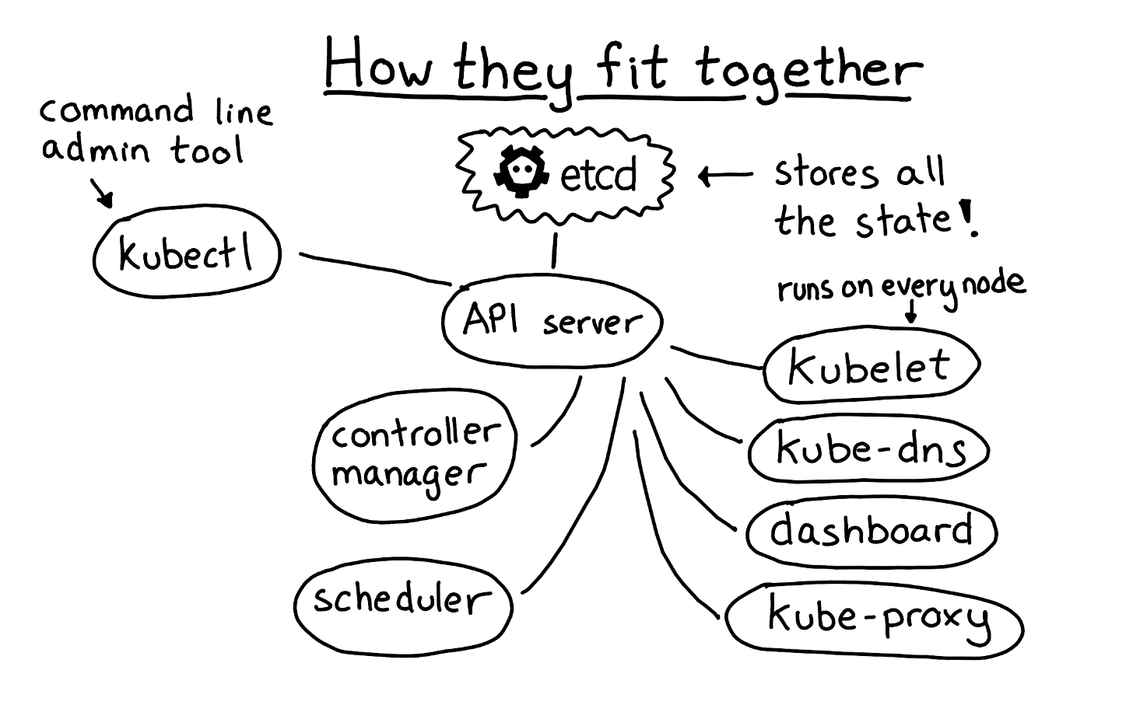
KUBELET:
• Agent running on the node
• Listen to k8s master (ex: pod creation request)
• Use port 10255
• Sends success/fail report to master.
CONTAINER ENGINE:
• Works with kublets
• Pulling images
• Start /stop containers
• Exposing container on port specified in manifest.
KUBE-PROXY:-
• Assign IP to each pod
• It is required to assign IP address to Pods (dynamic)
• Kube-proxy runs on each node and this make sure
that each pod will get its own unique IP address.

Slide 19
Working with Kubernetes:
• We create manifest (json .yml)
• Apply this cluster to master (to master) to bring into desired state.
• Pods runs on node which is controlled by master.
Role of master node:
• Kubernetes cluster contains running on bare metal/VM instance /Cloud instances/All mix.
• Kubernetes designates one or more of these as master and all others are workers.
• The master is now going to run set of k8s process. These process will insure smooth functioning of cluster these process are called Control plane.
• It can be multi master for high availability.
• Master runs control plane to run cluster smoothly.

Slide 20
Components of Control Plane (master):
1. Kube-API server
2. Etcd
3. Kube-scheduler
4. Controller manager

Slide 21
1.Kube-API server (for all communications):
➢ This api-server interacts directly with user (i.e we apply .yml or json manifest to kube-apiserver).
➢ This kube-apiserver is meant to scale automatically as per load.
➢ Kube api-server is front-end of control-plane.
2. Etcd:
➢ It stores metadata and status of cluster.
➢ Etcd is consistent and high available store (key-value store).
➢ Source of touch for cluster state (info about state of cluster).
Etcd has following features: -
a. Fully replicated: the entire state is available on every node in the cluster.
b. Secure: implements automatic TLS with optional client-certificate authentication.
c. Fast: benchmarked at 10,000 writes per second.

Slide 22
3. Kube Scheduler:
When users make request for the creation and management of PODs, kube scheduler is going to take action on these requests.
Handles POD creation and management.
Kube scheduler match/ assign any node to create and run PODs.
A scheduler watches for newly created PODs that have no node assigned. For every POD that the scheduler discovers the scheduler becomes responsible for finding best node for that POD to run on.
Scheduler gets the information for hardware configuration from configuration file and schedules the PODs on nodes accordingly.
4. Controller Manager:
Make sure that actual state of cluster matches the desired state.
Two possible choices for controller manager:
a. If k8s on cloud, then it will be cloud-controller-manager.
b. If k8s on non-cloud then it will be kube-controller-manager

Slide 23
Components on master that runs controller:
a. Node controller: for checking the cloud providers to determine of a node has been detected in the cloud after id stops responding.
b. Route controller: responsible for setting up network, routes on your cloud.
c. Service controller: responsible for load balancers on your cloud against services of type load balancers.
d. Volume controller: for creating, attaching and mounting volumes and interacting with the cloud provider to orchestrate volume.

Slide 24
POD:
➢ Smallest unit in Kubernetes.
➢ POD is a group of one or more containers that are deployed together on the same host.
➢ A cluster is a group of nodes.
➢ A cluster has at least one worker node and master node.
➢ In Kubernetes the control unit is the POD, not containers.
➢ It consists of one or more tightly coupled containers.
➢ POD runs on node which is control by master.
➢ Kubernetes only knows about PODs (does not know about individual container).
➢ Cannot start containers without a POD.
➢ One POD usually contains one container.

Slide 25
Multi container PODs:
➢ Share access to memory space.
➢ Connect to each other using local host <container port>.
➢ Share access to the same volume.
➢ Containers within POD are deployed in an all-or-nothing manner.
➢ Entire POD is hosted on the same node (scheduler will decide about which node).
POD limitations:
➢ No auto healing or auto scaling.
➢ POD crashes.

Slide 26
Higher level Kubernetes objects:
a. Replication set: auto scaling and auto healing
b. Deployment: versioning and rollback
c. Service:
d. Static (non-ephemeral) IP and networking.
e. Volume: non-ephemeral storage.
Important:
Kubectl- single cloud
Kubeadm- on premise
Kubefed- federated

Slide 27
The basic Kubernetes objects includes
1. Pod
2. Service
3. Volume
4. Namespace
5. ReplicaSets controller
6. Secrets
7. Configmaps
8. Deployments
9. Jobs
10.Demonsets
11.NodePort
12. Replication controller
Relationship between these object
pod manages containers
replicaset manage pods
service expose pod process to the outside world
configmaps and secrets help you configure pods.

Slide 28
DEMO: Setup Kubernetes master and node on AWS:
Login into AWS account – launch 3 instances – ubuntu (t2.medium)
Master must have 2vcpu and 4gb RAM
Now using puttygen, create private key
Access all the 3 instances (1 master, 2 node) using putty.

Slide 29
Kubernetes v1.20 installation - Ubuntu
The issue is with the latest version of Kubernetes. This is a bug in version 1.22. Installing an older version (1.20) will resolve the issue. Create a new instance and follow the below steps,
1. Install docker.
Execute the below command to switch to the root user,
sudo su
Create a file with the below command,
nano docker.sh
Add the below contents in this file,
swapoff -a
apt update -y
apt install -y docker.io
systemctl enable docker
systemctl start docker
Now execute the below commands to run the above file and install docker,
chmod -R 777 docker.sh
./docker.sh

Slide 30
2. Install Kubernetes
Create a file with the below command,
nano kubernetes.sh
Add the below contents in this file,
sudo apt-get update && sudo apt-get install -y apt-transport-https curl
curl -s https://packages.cloud.google.com/apt/doc/apt-key.gpg | sudo apt-key add -
cat <<EOF | sudo tee /etc/apt/sources.list.d/kubernetes.list
deb https://apt.kubernetes.io/ kubernetes-xenial main
EOF
sudo apt-get update
sudo apt-get install -y kubelet=1.20.2-00 kubeadm=1.20.2-00 kubectl=1.20.2-00
sudo apt-mark hold kubelet kubeadm kubectl
Now execute the below commands to run the above file and install Kubernetes,
chmod -R 777 kubernetes.sh
./kubernetes.sh

Slide 31
3. Initialize the cluster with the below command,
kubeadm init --apiserver-advertise-address=<your private IP address> --pod-network-cidr=192.168.0.0/16 --ignore-preflight-errors all
Change the private IP accordingly.
When the cluster is initialized Successfully it will print the kubeadm join command. Note that command as you will have to execute it in the worker node to connect it to the master later.
Now, execute the below commands in the master one-by-one,
exit
mkdir -p $HOME/.kube
sudo cp -i /etc/kubernetes/admin.conf $HOME/.kube/config
sudo chown $(id -u):$(id -g) $HOME/.kube/config
kubectl apply -f https://raw.githubusercontent.com/coreos/flannel/master/Documentation/kube-flannel.yml

Slide 32
4. Follow the Step 1 and 2 in worker node as well
5. Now execute the kubeadm join command in the worker node from the root user
6. Now execute the below command in the master node,
kubectl get nodes

Slide 33
MINIKUBE
Install Docker
$ sudo apt update && apt -y install docker.io
Install kubectl
$ curl -LO https://storage.googleapis.com/kubernetes-release/release/$(curl -s https://storage.googleapis.com/kubernetes-release/release/stable.txt)/bin/linux/amd64/kubectl && chmod +x ./kubectl && sudo mv ./kubectl /usr/local/bin/kubectl
Install Minikube
$ curl -Lo minikube https://storage.googleapis.com/minikube/releases/latest/minikube-linux-amd64 && chmod +x minikube && sudo mv minikube /usr/local/bin/
Start Minikube
$ apt install conntrack
$ minikube start --vm-driver=none
$ minikube status

Slide 34
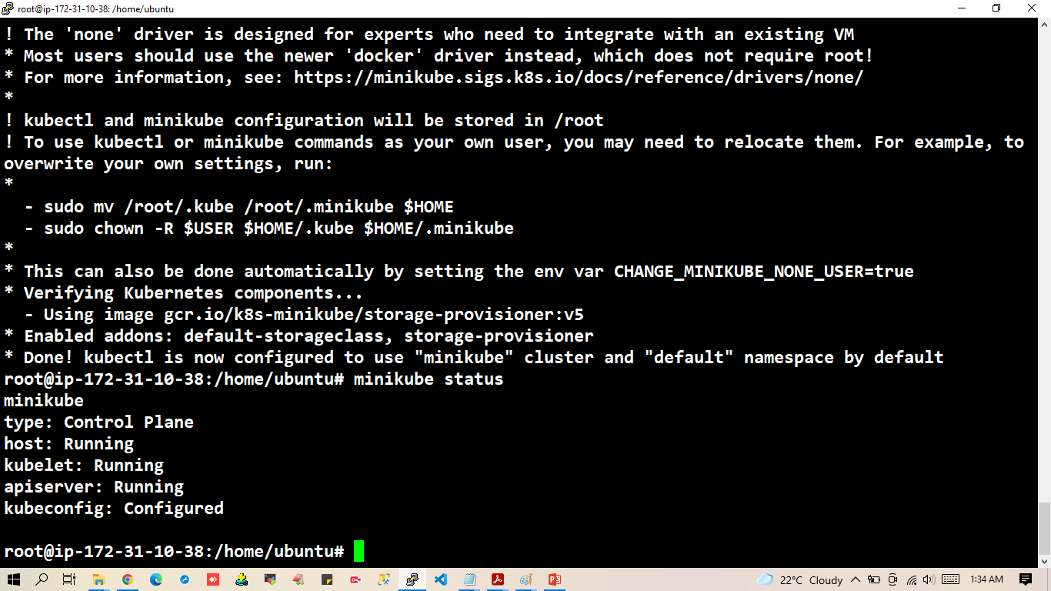

Slide 35
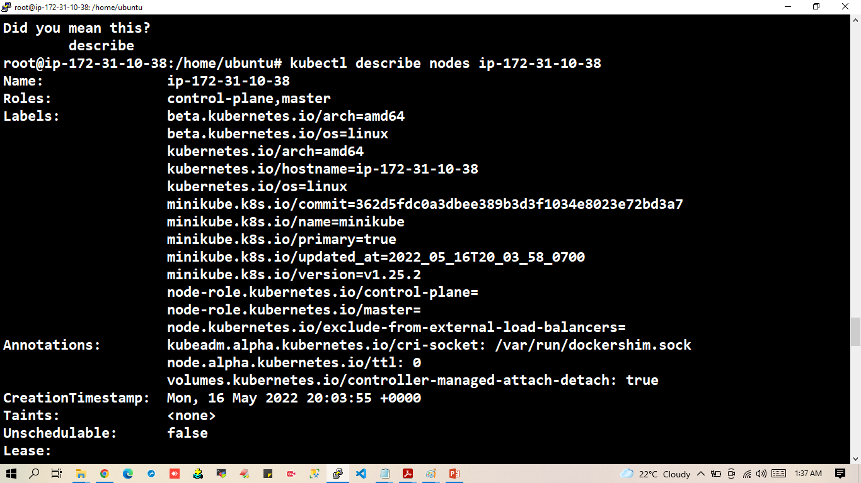

Slide 36
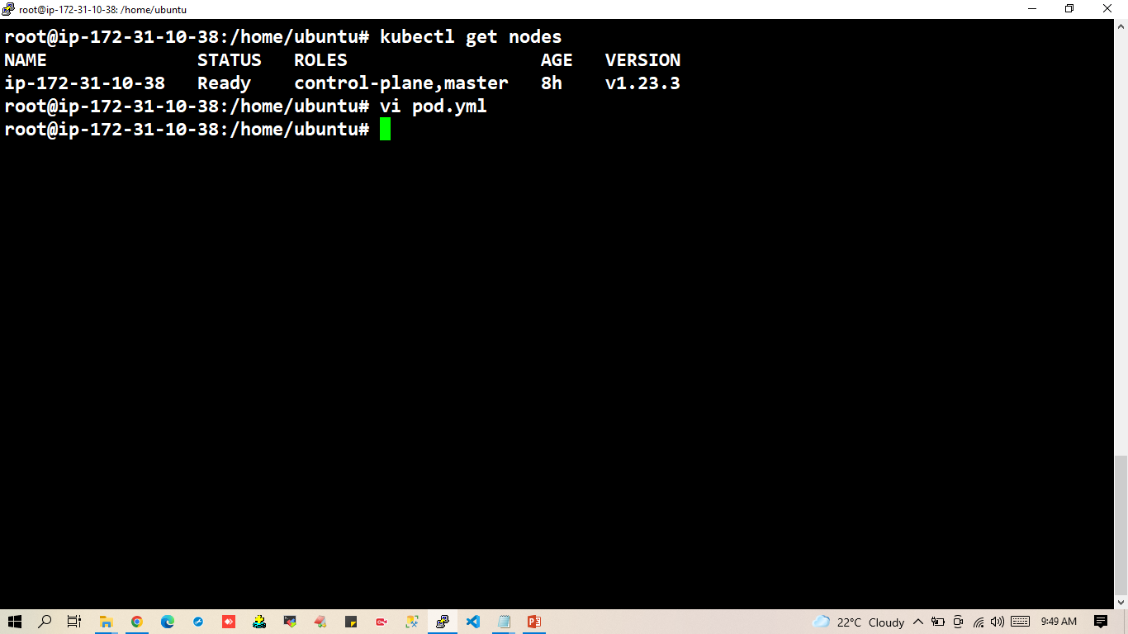

Slide 37
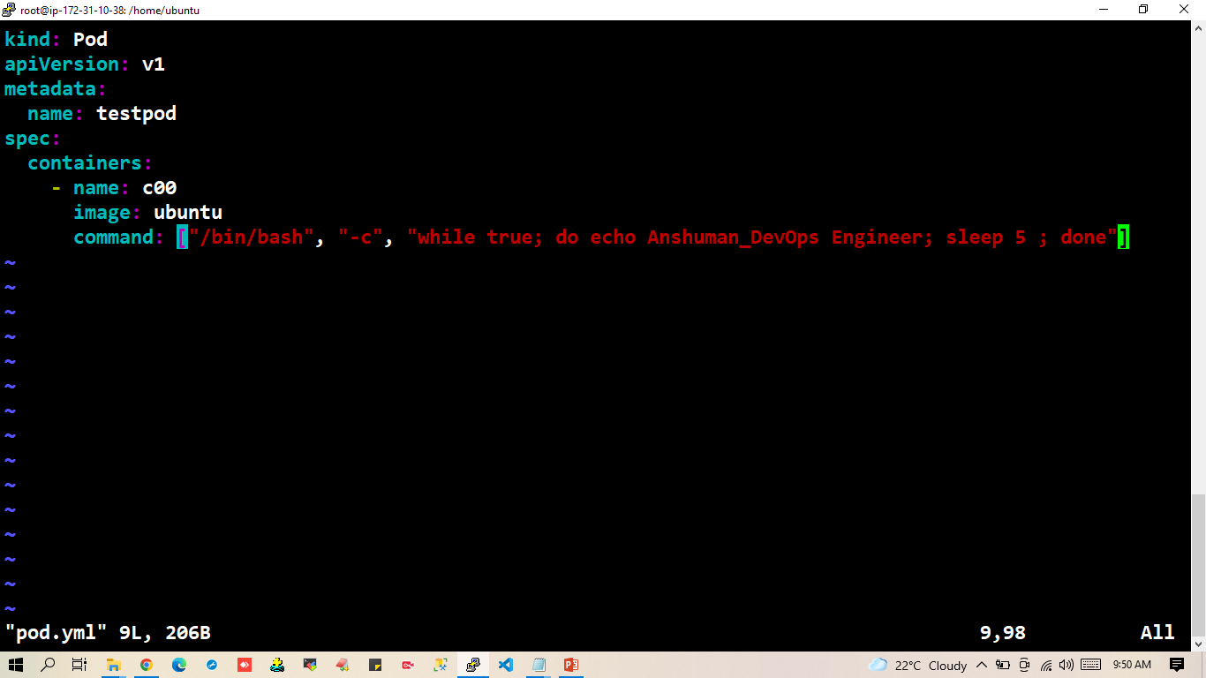

Slide 38
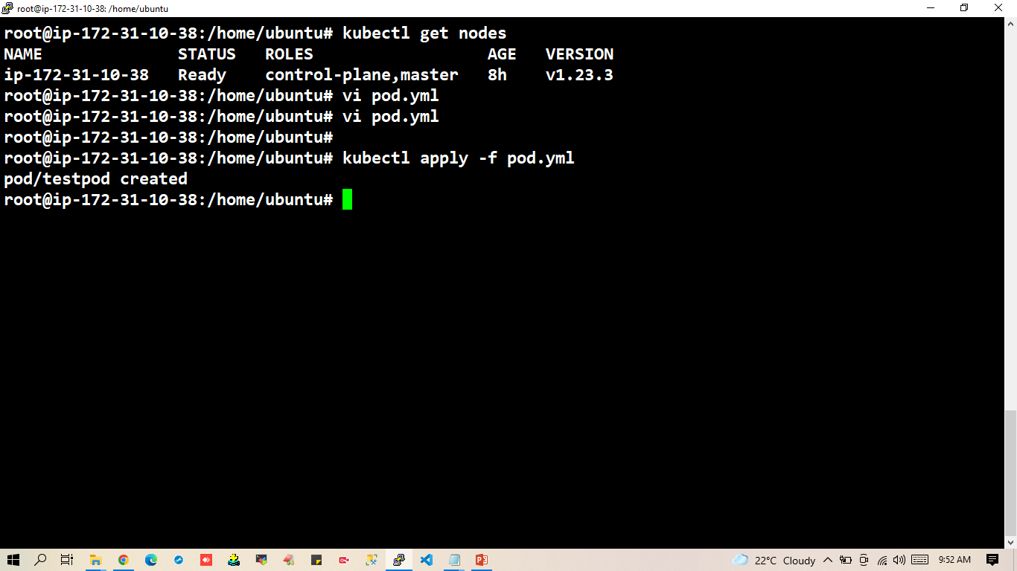

Slide 39
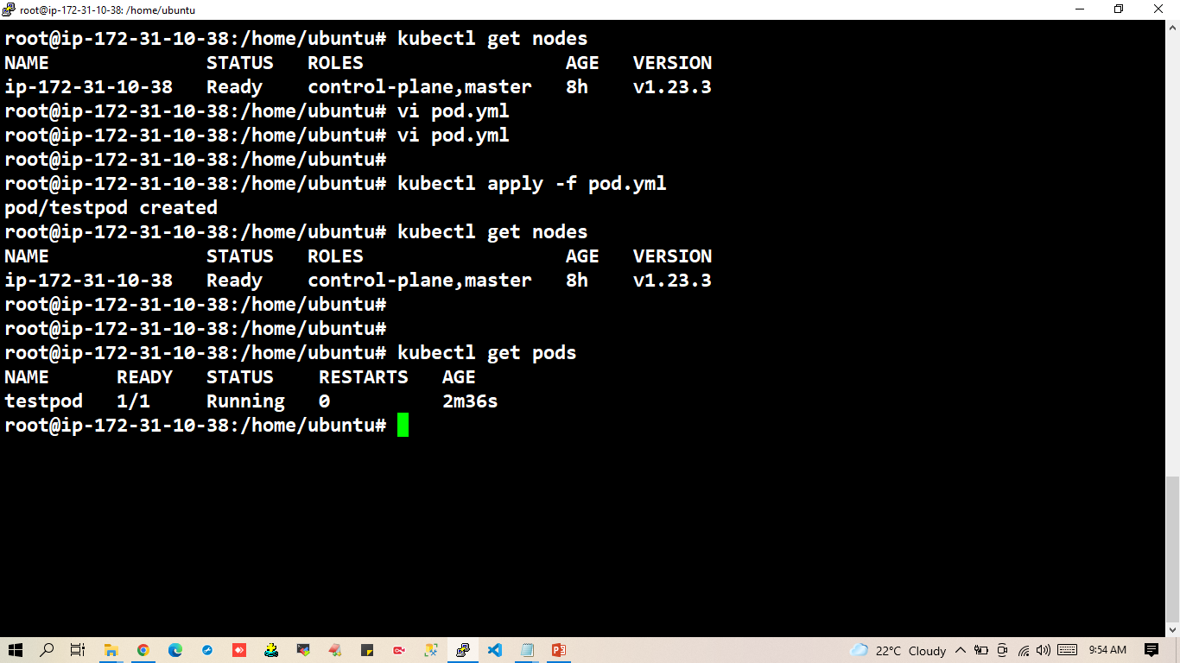

Slide 40
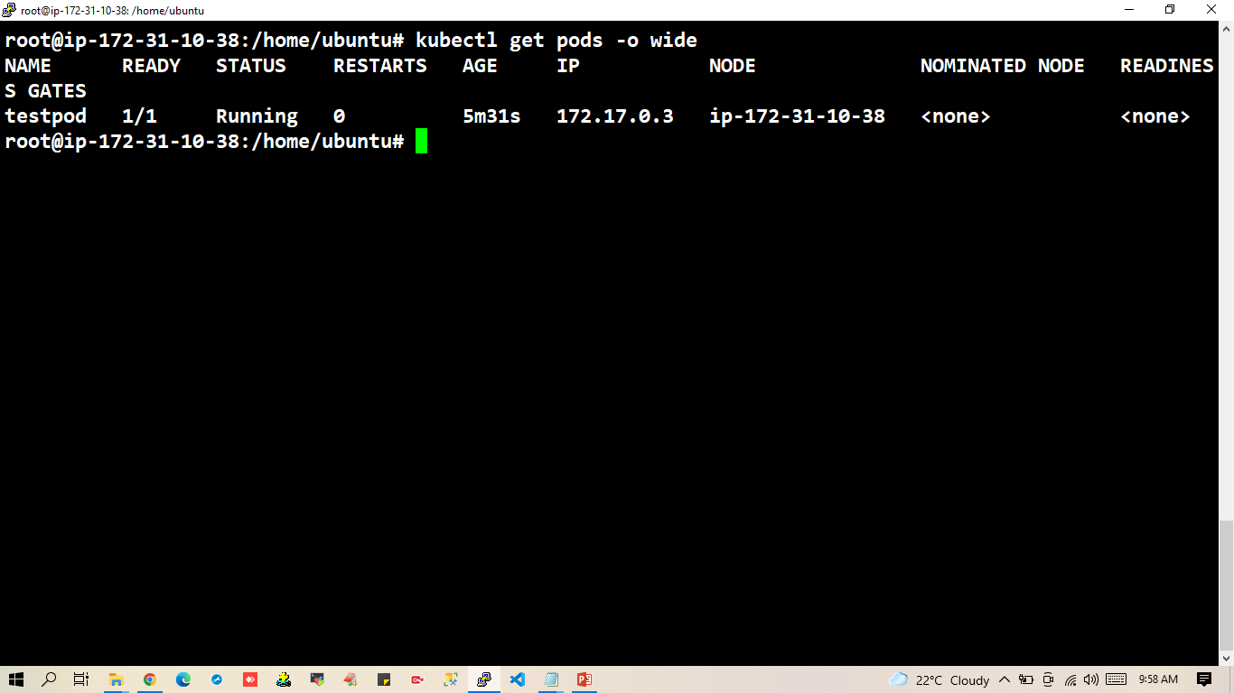

Slide 41
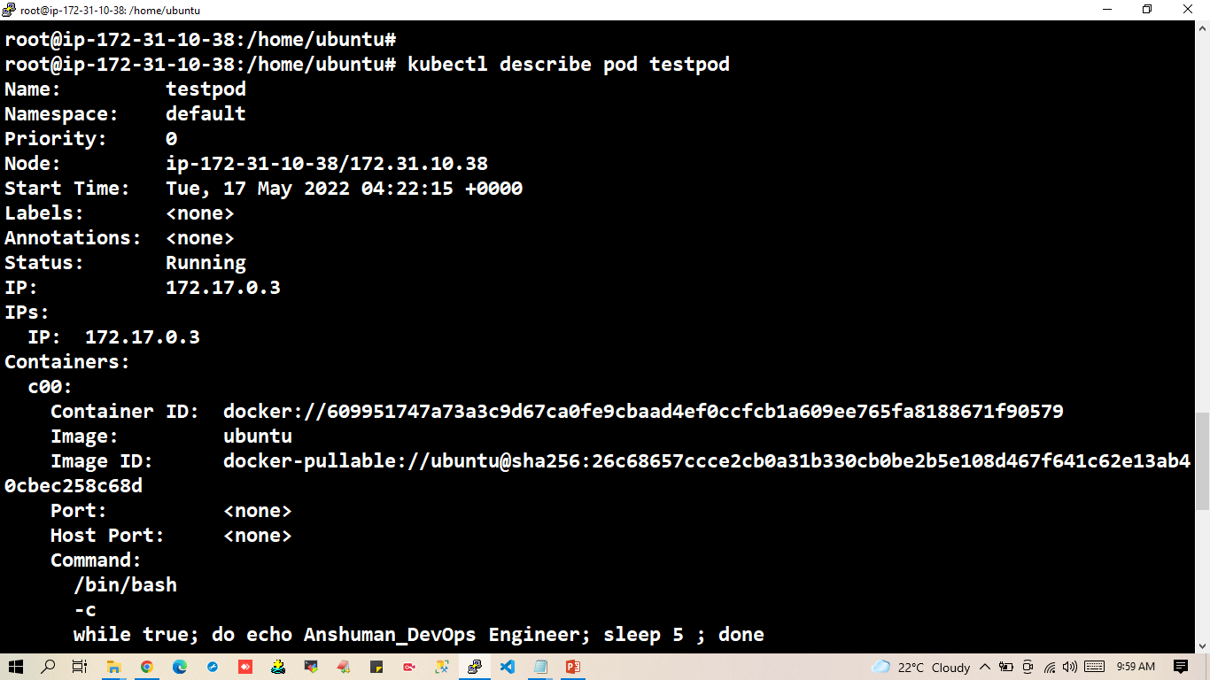

Slide 42
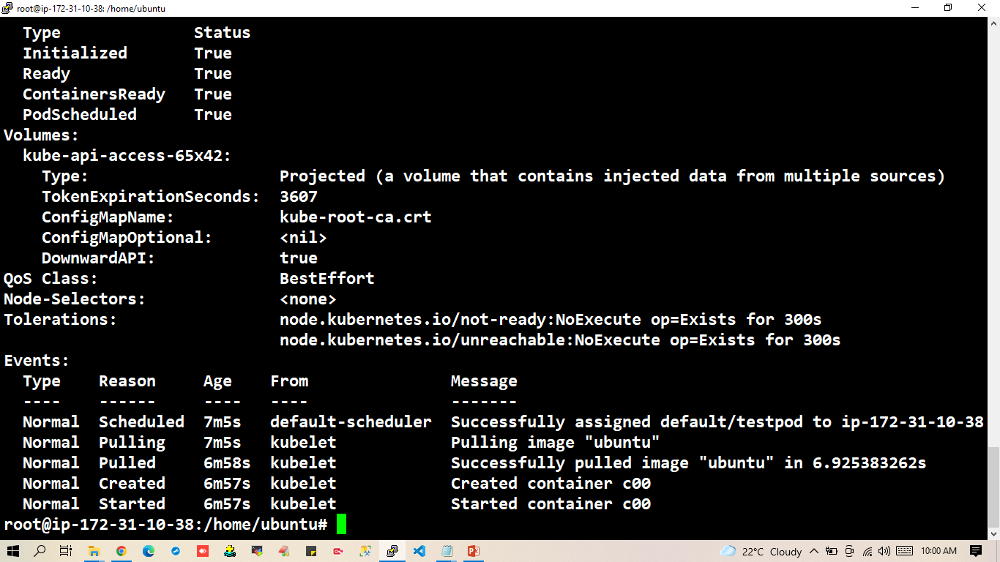

Slide 43
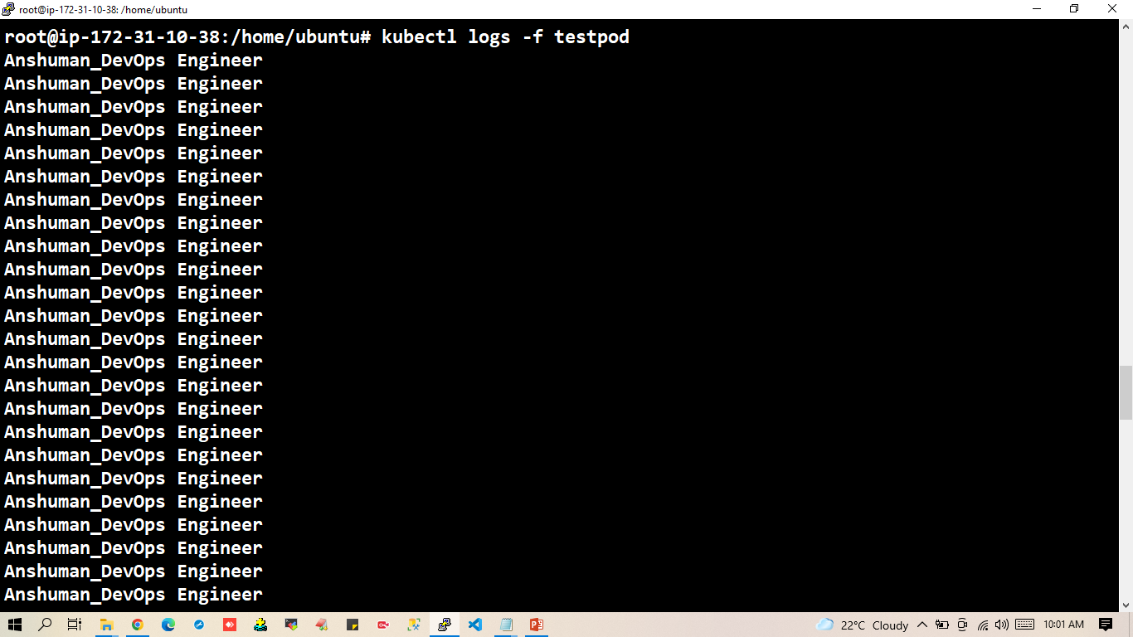

Slide 44
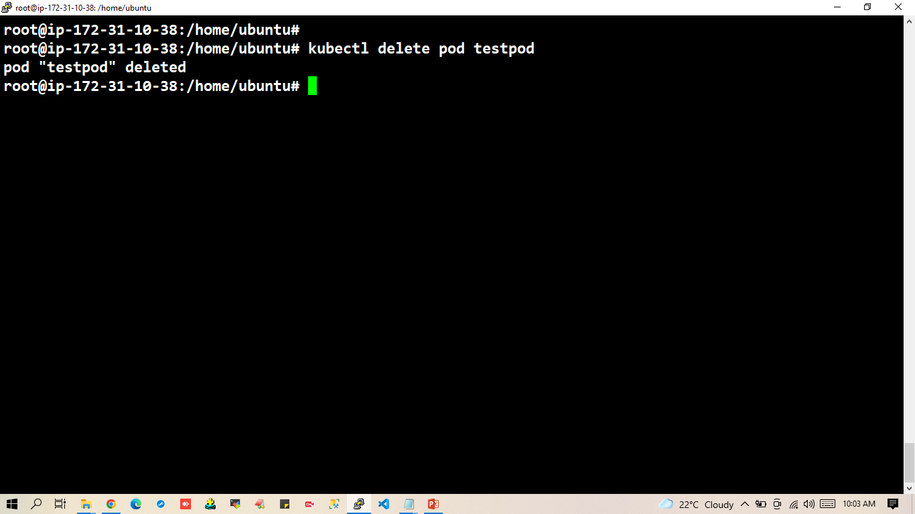

Slide 45
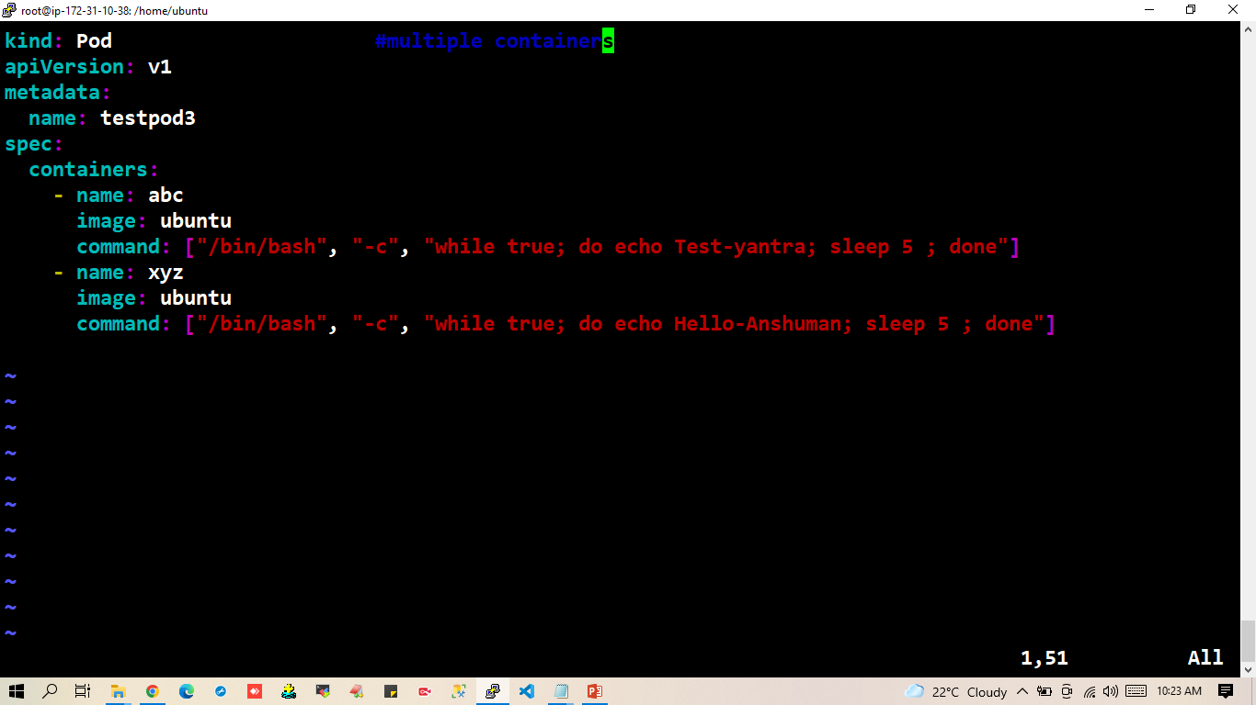

Slide 46
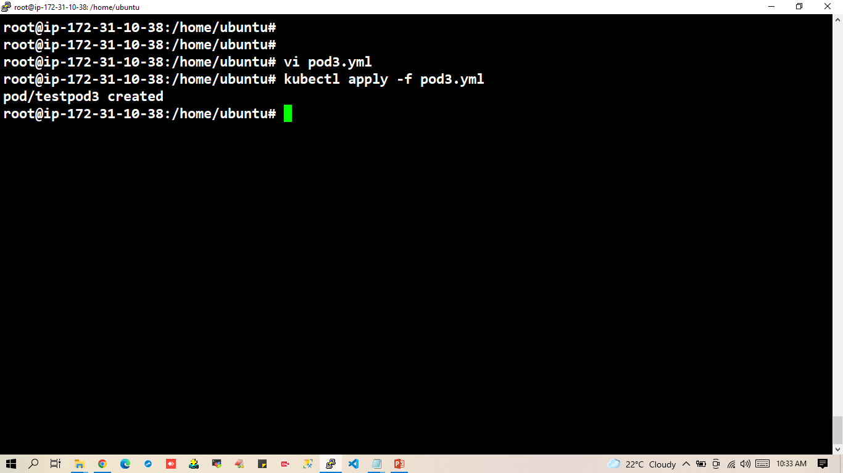

Slide 47
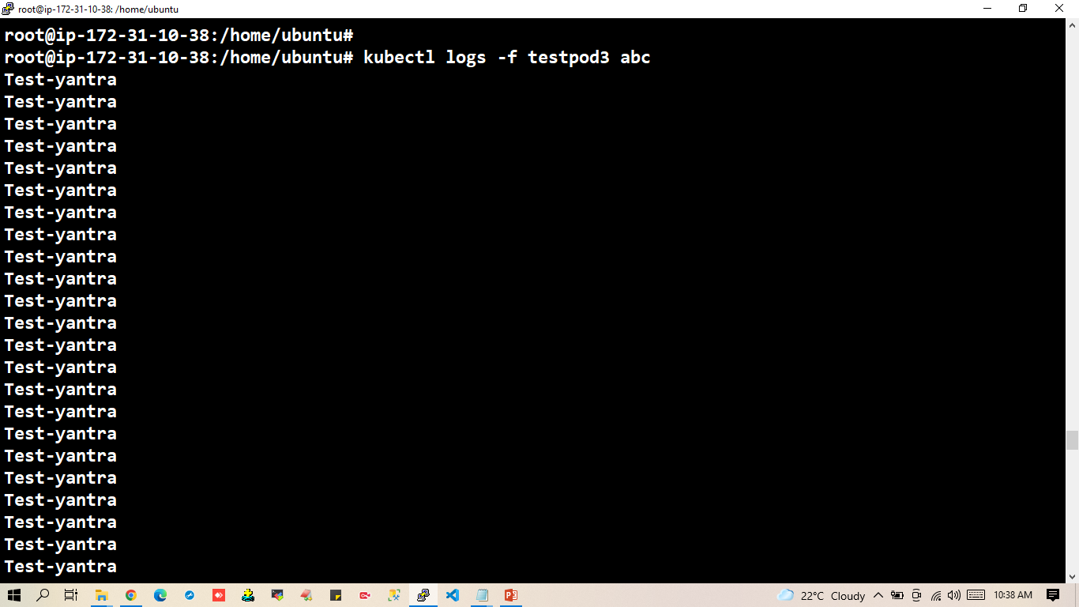

Slide 48
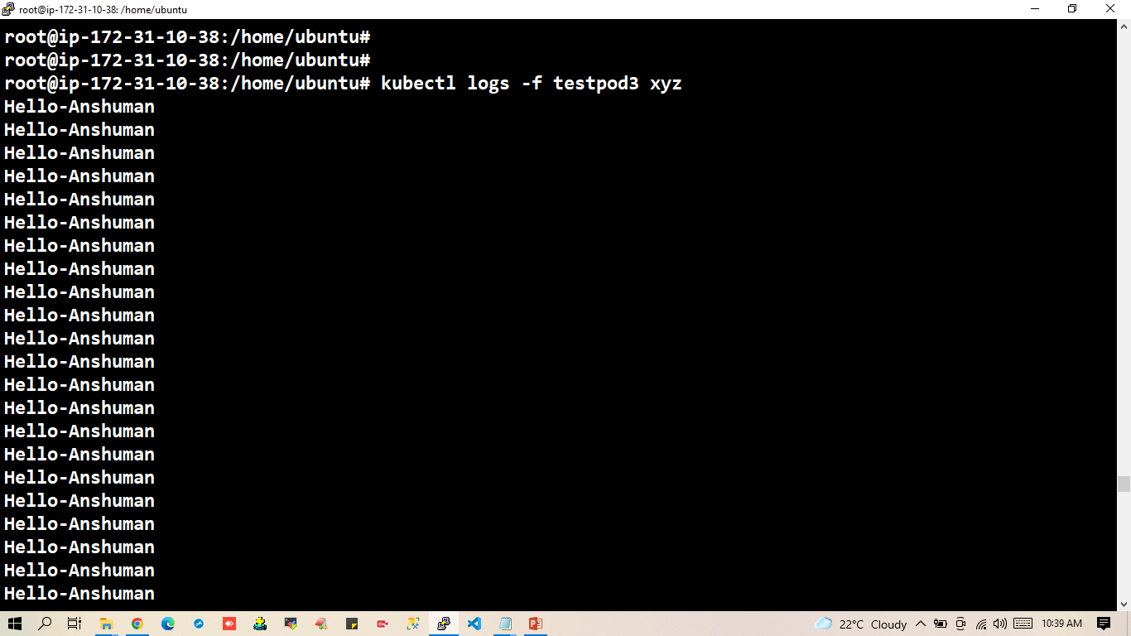

Slide 49
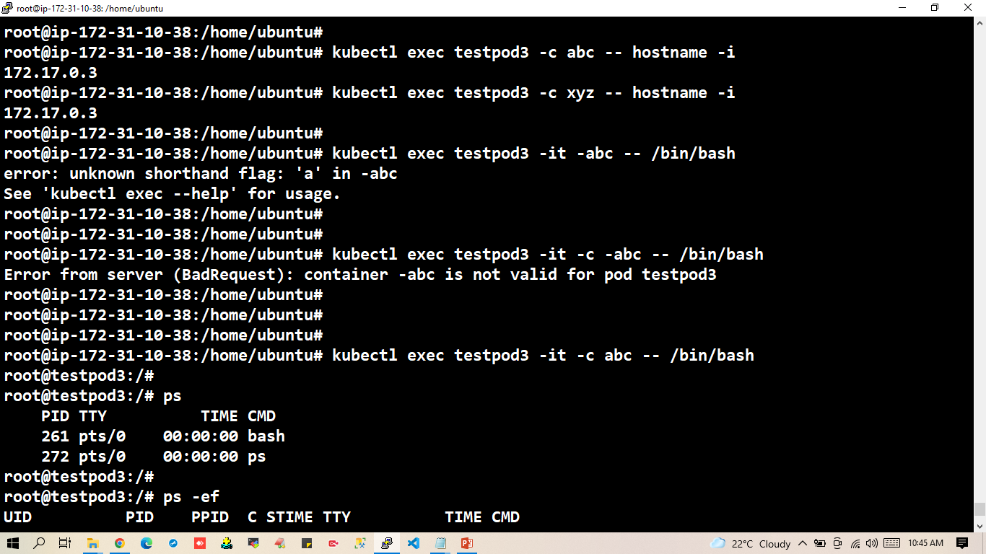

Slide 50
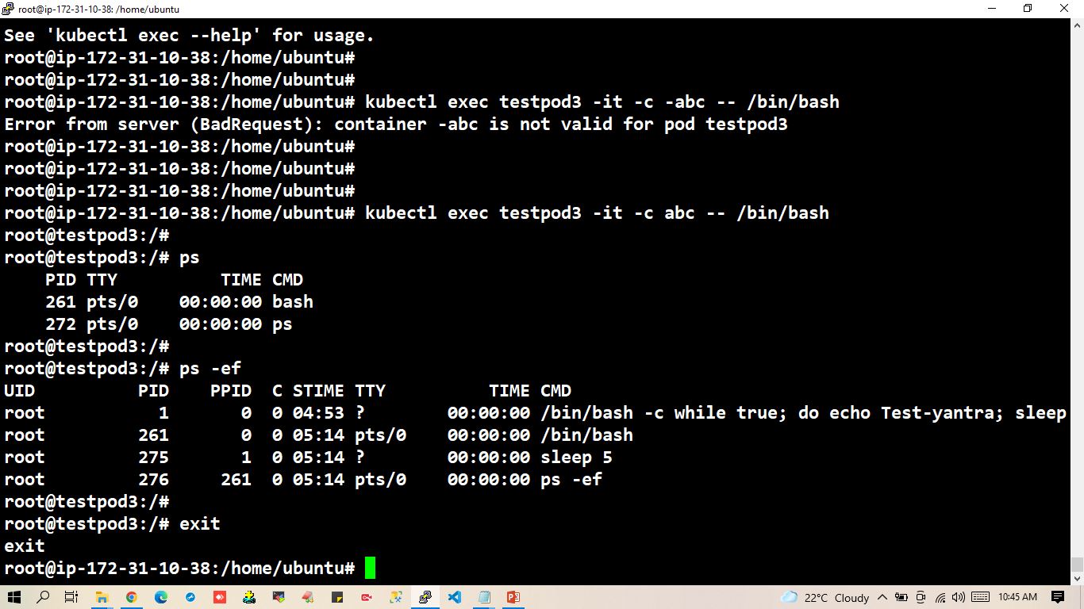

Slide 51
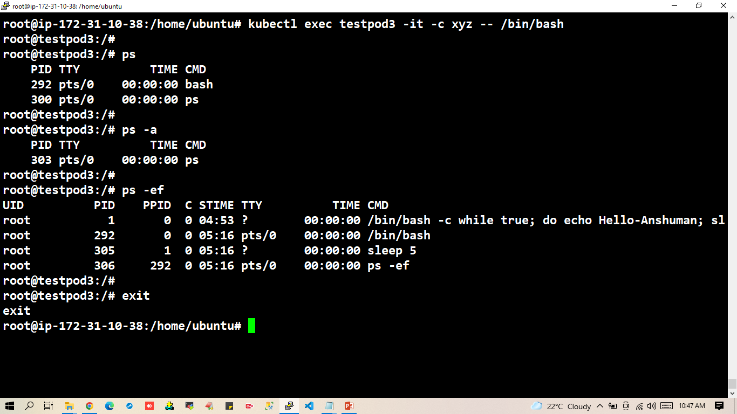

Slide 52
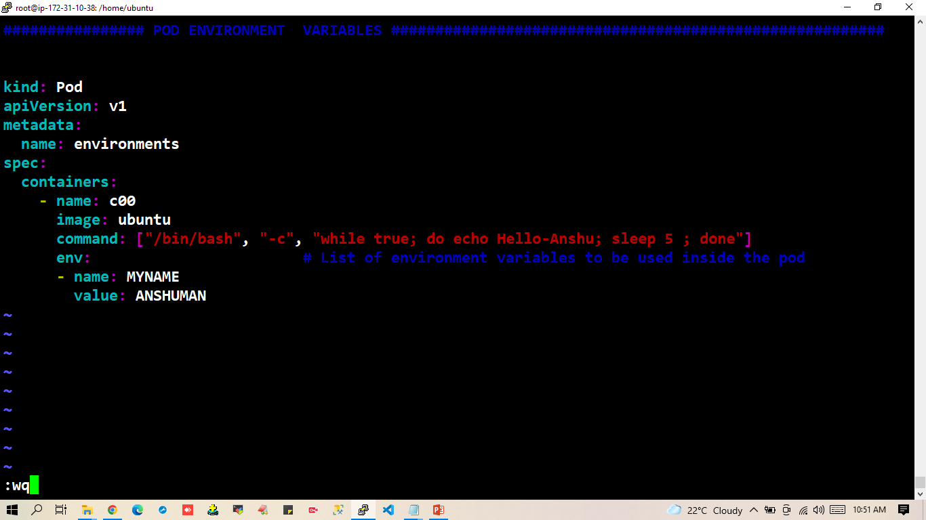

Slide 53
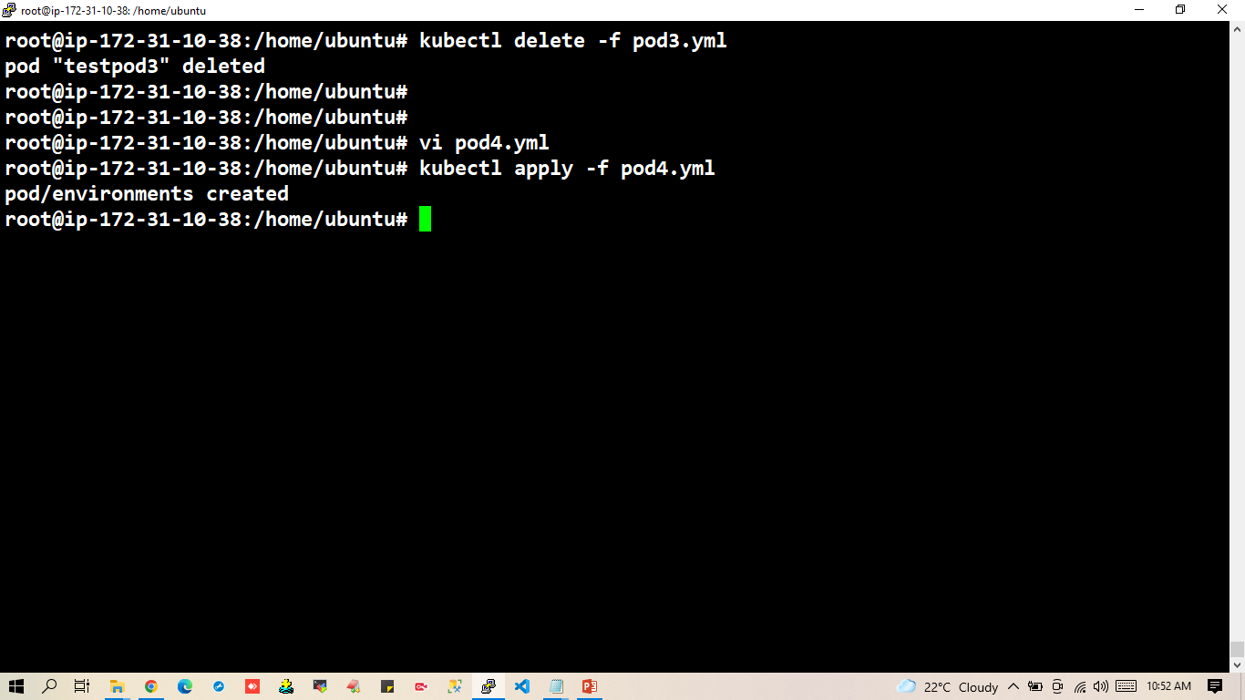

Slide 54
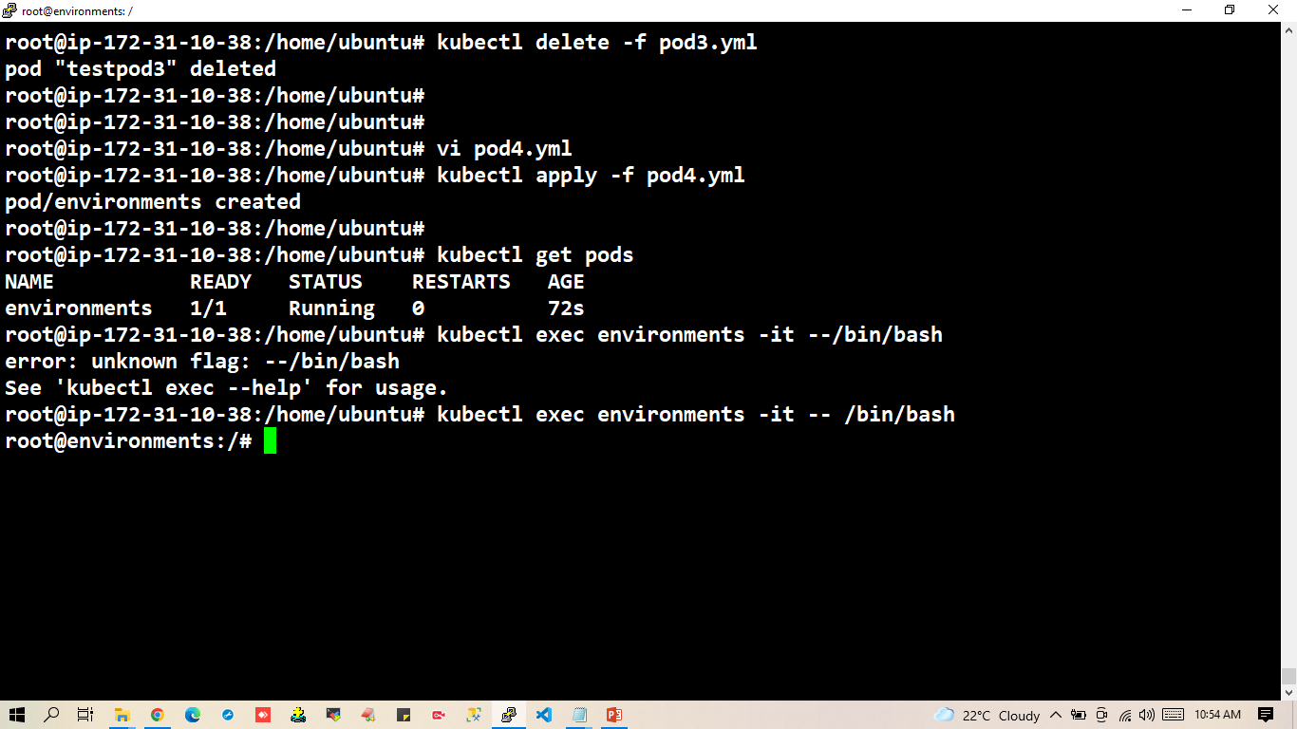

Slide 55
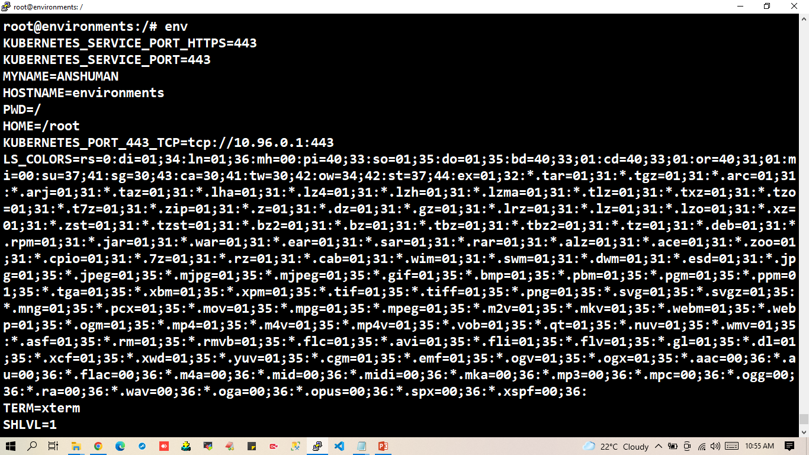

Slide 56
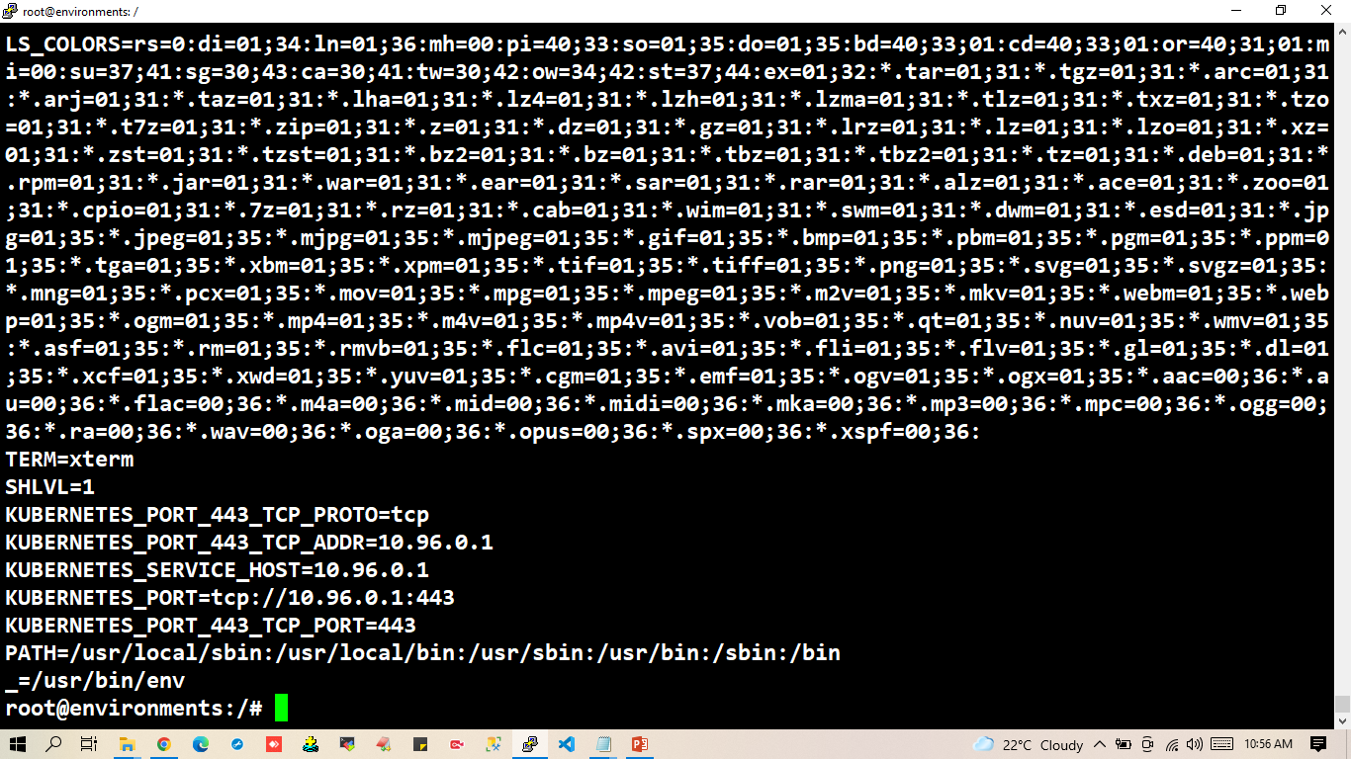

Slide 57


Slide 58


Slide 59


Slide 60


Slide 61
Label and selectors
Labels are the mechanism you use to organic kubernetes objects.
A level is a key-value pair without any predefined meaning that can be attached to the objects.
Labels are similar to tags in AWS or GIT where you use a name to quick reference.
Multiple labels can be added to a single object.

Slide 62


Slide 63


Slide 64
Scaling and Replication
kubernetes was designed to orchestrate multiple containers and replication.
Need for multiple containers/replication helps us with these.
Reliability By having multiple versions of an application you prevent problems if one or more fails.
Load Balancing Having multiple version of containers enables you to easily send traffic to different instance to prevent Overloading of a single instances or node.
Scaling When load becomes too much for number of existing instances, kubernetes enables you to easily scale up your application, adding additional instances as needed.
Rolling Updates updates to a service by replacing pod one by one.

Slide 65
Replication Controller
A Replication Controller is a object that enables you to easily create multiple pods always exist.
If a pod create using RC will be automatically replaced if they does crash , failed or terminated.
RC is recommended if you just want to make sure 1 pod is always running, even after system reboots.
You can change RC with 1 replica and the RC will make sure the pod is always running.

Slide 66


Slide 67


Slide 68


Slide 69


Slide 70


Slide 71


Slide 72
Replica Set
Replica set is a next generation replication controller.
The replication controller only supports equality-based selector whereas the replica set supports set-based selector that is filtering according to set of values.
ReplicaSet rather than the Replication Controller is used by other objects like deployment.

Slide 73


Slide 74
Deployment
Replication Controller & Replica Set is not able to do updates rollback apps in the cluster.
A deployment object act as a supervisor for pods, giving you fine-grained control over how and when a new pod is Rolled Out, Update or Rolled Back to a Previous state.
when using deployment object, we first defined the state of an app, then K8s cluster schedules mentioned app instance on its specific individual nodes
A deployment provides declarative updates for pods & ReplicaSet
K8s then monitors, if the node hosting an instance goes down or pod is deleted the deployment controller replace it.
The provides a self-healing mechanism to address machine failure or maintenance.

Slide 75
When you inspect the deployments in your cluster, the following fields are display
NAME list the names of the deployments in the namespace
READY display how many repicas of the application are available to your user if follows the pattern ready/desired
UP-TO-DATE display the numberof raplicas that have been update to achieve the disered state
AVAILABLE displays how many raplicas of the application are available to your users
AGE display the amount of time that the application has been running

Slide 76
Failed Deployment
Your deployment may get stuck trying to deploy its newest ReplicaSet without ever completing. This can occur due to some of the following factors
Insufficient Quota
Readiness probe failures
Image pull errors
Insufficient permission
Limit Ranges
Application runtime configuration

Slide 77


Slide 78


Slide 79


Slide 80


Slide 81


Slide 82


Slide 83


Slide 84


Slide 85
Kubernetes Networking address for concerns
Container within a pod use networking to communicate via loopback.
Cluster networking provides communication between different pods.
The service resources let you expose an application running in pods to be reachable from outside your cluster.
You can also use services only for consumption inside your cluster.
5. Container to container communication on same pod happens through localhost within the containers.

Slide 86


Slide 87


Slide 88


Slide 89


Slide 90
Communication established between two different pod within same node.
Pod to Pod communication on same worker node happens through pod ip.
By default pod's ip will not be accessible outside the node.

Slide 91


Slide 92


Slide 93


Slide 94


Slide 95


Slide 96


What is a Service?
A Service in Kubernetes is an abstraction which defines a logical set of Pods and a policy by which to access them. Services enable a loose coupling between dependent Pods. A Service is defined using YAML (preferred) or JSON, like all Kubernetes objects.

Slide 97
Object- Services
Each pod gets its own ip address, however in a deployment, the set of pods running in one moment in time could be different from the set of pods running that application a moment later.
This leads to be a problem:
If some set of pods (call them "backends") provides functionality to other pods (call them "frontend") inside your cluster, how do the frontends find out and keep track of whics ip address to connect to, so that the frontend can use the backend part of the workload?

Slide 98

Types of Service

Slide 99

Service nodeport
Downsides
You can only have one service per port.
You can only use ports 30000 to 32767.
If you node/vm IP address change, we will have to change the configuration.

Slide 100
Although each pod has a unique ip address, these ip are not exposed outside the cluster.
Service have to expose the vip(virtual ip), mapped to the pods and allows application to receive traffic.
Labels are used to select which are pods to be put under a service.
Creating a service will create an endpoint to access the pod/application in it .

Slide 101


Service LoadBalancer

Slide 102

Ingress
Kubernetes Ingress is an API object that provides routing rules to manage external users' access to the services in a Kubernetes cluster, typically via HTTPS/HTTP.
With Ingress, you can easily set up rules for routing traffic without creating a bunch of Load Balancers or exposing each service on the node.

Slide 103


Cluster IP
Exposes VIP only reachable from within the cluster.
Mainly used to communicate between Component and Micro services.

Slide 104


Slide 105


Slide 106


Slide 107


Slide 108


Slide 109


Slide 110

NODEPORT
Makes a service accessible from outside the cluster.
Expose the service on the same port of each selected node in the cluster using NAT.

Slide 111


Slide 112


Slide 113


Slide 114


Slide 115


Slide 116
Resource Quota
Quota
limits CPU: "600m“
limits memory: "800m"
request CPU: "200m"
request memory: "500m"
Default Range
CPU request (min) --- 0.5
CPU limit (max) --- 1
memory request (min) --- 500m
memory limit (max) --- 1G

Slide 117


Slide 118


Slide 119


Slide 120


Slide 121


Slide 122


Slide 123


Slide 124


Slide 125


Slide 126


Slide 127


Slide 128


Slide 129


Slide 130


Slide 131


Slide 132


Slide 133


Slide 134
Horizontal Pod Autoscaler (HPA)
Kubernetes has the possibility to automatically scale pods based on observed CPU Utilization, which is horizontal pod Auto scaling.
Scaling can be done only for scalable objects like Controller, Deployment or Replica Set.
HPA(Horizontal Pod Autoscaler) is implemented as a kubernetes API resource and a controller
The Controller periodically adjust the number of replicas in a application. Controller or Deployment to match the observed average CPU Utilization to the target specified by user.
The HPA is implemented as a controlled loop with a period controlled by the controller manager's-horizontal-pod-autoscaler-sync-period flag (Default value of 30 Sec).
During each period, the controller manager quaries the resource Utilization against the metrics specified in each horizontal pod-Autoscaler definition.

Slide 135


Slide 136

wget -O metricserver.yml https://github.com/kubernetes-sigs/metrics-server/releases/latest/download/components.yaml

Slide 137


Slide 138


Slide 139


Slide 140


Slide 141


Slide 142


Slide 143


Slide 144


Slide 145


Slide 146


Slide 147


Slide 148


Slide 149
Thankyou…

